Slide 1
Bray-Curtis
Weighted Unifrac
Beta 1:
Jaccard
Unweighted Unifrac
Beta 2:

Slide 2
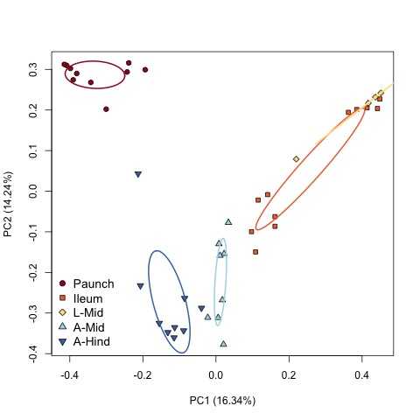
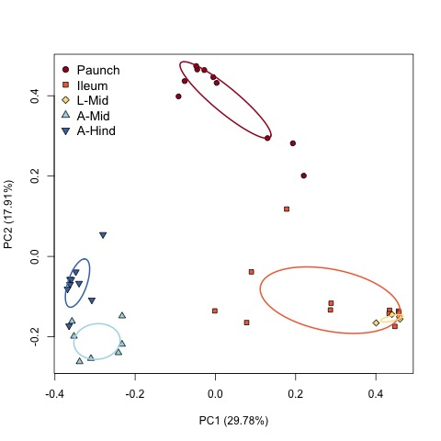
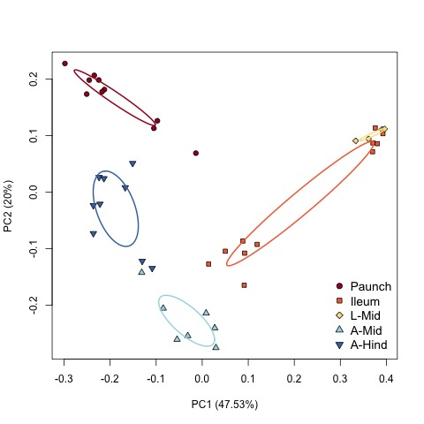
DEPRECATED VERSION
Bray-Curtis
Unweighted UniFrac
Weighted UniFrac

